Slide 1


Session 2: Data types and operators
Middlesex Computing Society: Python Programming
Arfa Kazi, Head of Python Programming

Slide 2

Last week’s recap
Introduction to Python and its applications
Installing and setting up the Python environment
Learnt basic syntax, Input/Output Operations and variables
print(), input() and declaring variables.

Slide 3

This Week’s objectives:
Differentiate between the different data types
Understand concepts like dynamic typing and Type Casting
Use the different operators to perform operations
Learn about Complex data Types such as Lists and Dictionaries

Slide 4
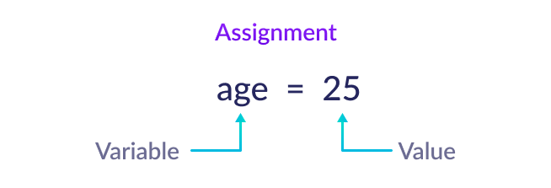
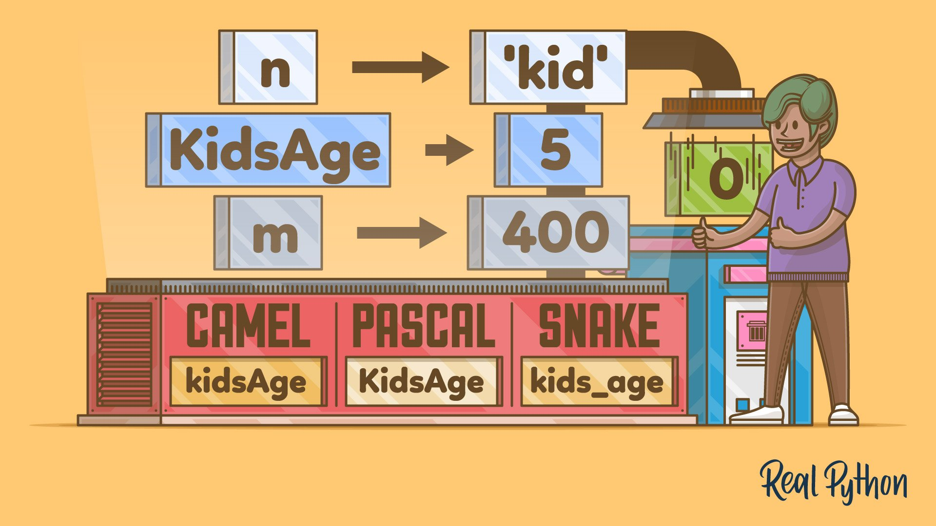
Variables in Python
What are Variables?
Variables are containers for storing data values.
Creating or Declaring a variable:
Syntax: VariableName = [value]
message = "Hello, World!"
age = 25
pi = 3.14
Naming Variables
Can contain letters, numbers, underscores (_).
Must start with a letter or underscore.
Case-sensitive (age vs. Age).
Recap from last week…

Slide 5


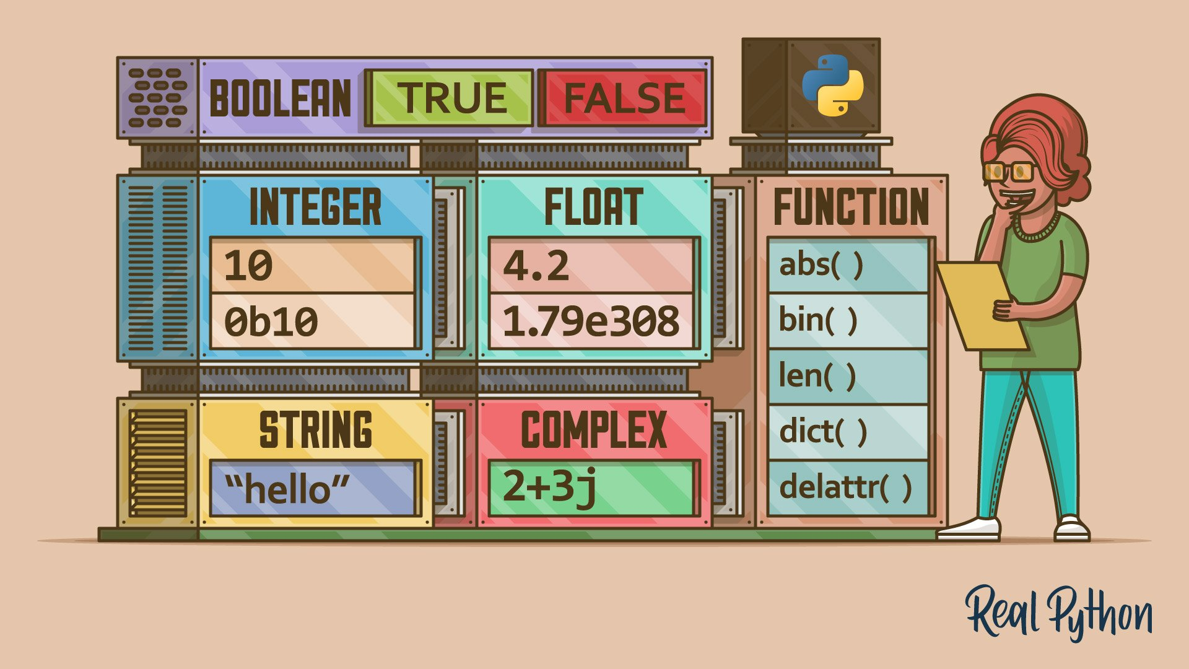
Data types
Categories of data that tell python how to handle them.

Slide 6
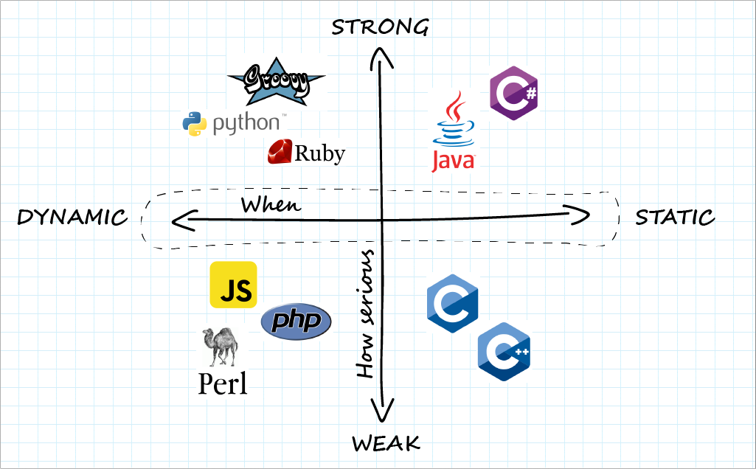
Dynamic typing
What is Dynamic Typing?
Allows variables to change type at runtime.
You don't need to declare the type of a
variable when you create it.
Examples:
Initial Assignment: x = 10 # x is an integer
Type Change: x = "Hello" # Now, x is a string
Note: Use the type() function to see the type of a variable.

Slide 7
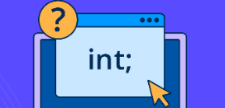
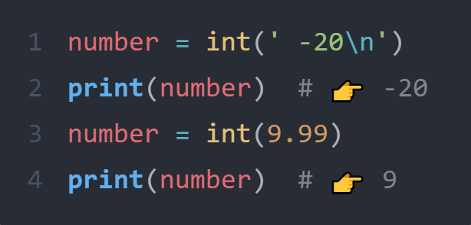
Integer
Whole numbers, both positive and negative, without a decimal point.
Constructor function: int()
Examples:
age = 25
year = 2024
temperature = -5
Usage: Arithmetic Operations, Addition, subtraction, multiplication, division, etc

Slide 8
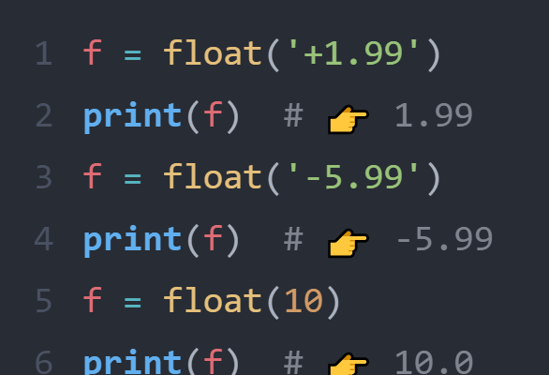
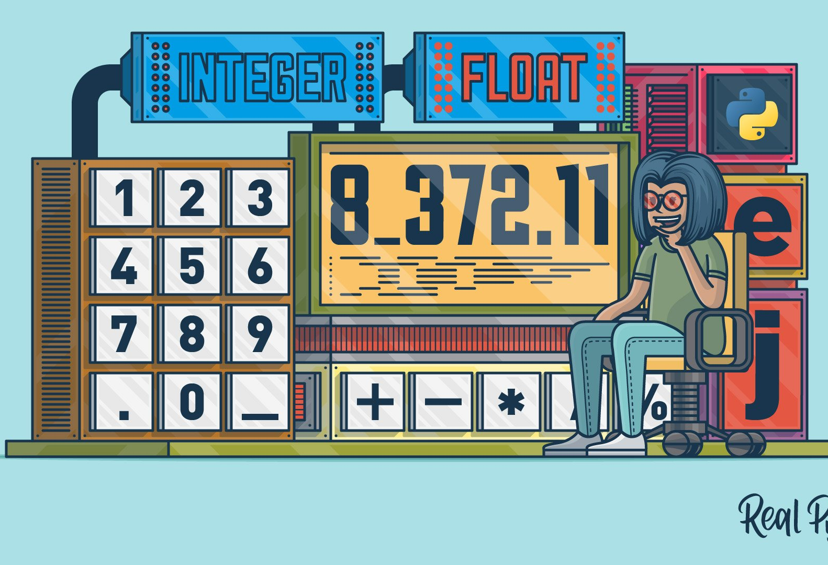
Float
Numbers that contain a decimal point.
Constructor function: float()
Examples:
pi = 3.14
price = 19.99
weight = -72.5
Usage: Precise Calculations, Scientific calculations, measurements, etc.

Slide 9
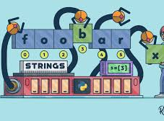
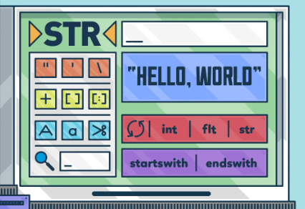
String
Sequence of characters enclosed in quotes.
Constructor function: str()
Examples:
name = "Alice"
greeting = 'Hello, World!'
Usage: Text Manipulation, Storing and manipulating text data.

Slide 10
String Operations
Concatenation: Combine strings using +
Eg:- full_name = "John" + " " + "Doe“
Repetition: Repeat strings using *
laugh = "ha" * 3 # Output: "hahaha"
Indexing: Access characters by position
letter = "Hello"[1] # Output: "e"
Slicing: Get a substring using [start:end]
sub = "Hello"[1:4] # Output: "ell"

Slide 11
String Operations (cont.)
Lowercase: string.lower()
name = "ALICE".lower() # Output: "alice"
Uppercase: string.upper()
name = “alice".upper() # Output: "ALICE"
Length: len(string)
length = len("Hello") # Output: 5

Slide 12
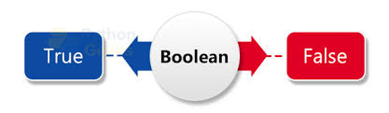
Boolean
Definition: Represents True or False values.
Represents True or False values.
Constructor function: bool()
Examples:
is_student = True
is_graduated = False
Usage: Flags, conditionals statements et.c

Slide 13
Type casting in python
Definition: Converting one data type to another.
Why? Useful when you need to perform operations on different data types together.
Common Type Casting:
Integer to String:
codeage = 25
age_str = str(age) # "25“
String to Integer:
codenum_str = "10“
num = int(num_str) # 10
String to Float:
codeprice_str = "19.99“
price = float(price_str) # 19.99
Float to Integer:
codepi = 3.14
pi_int = int(pi) # 3

Slide 14
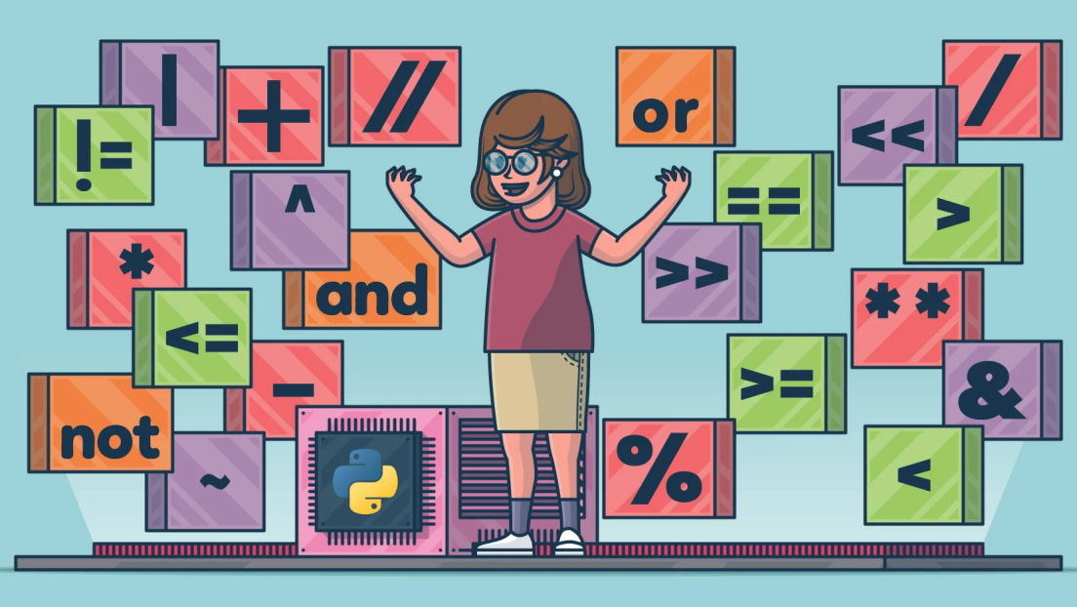
Operators
Symbols that perform operations on variables and values.

Slide 15
Arithmetic Operators
Addition
Subtraction
Multiplication
Division
Modulus
Exponentiation
Floor Division
+
-
*
/
%
**
//
Perform basic mathematical operations.

Slide 16
Comparison Operators
Equal
Not Equal
Greater Than
Less Than
Greater Than or Equal To
Less Than or Equal To
==
!=
>
<
>=
<=
Compare values and return a boolean result. (True, False)

Slide 17
Logical Operators
AND: and
OR: or
NOT: not
Example:-
a = True
b = False
print(a and b) # Output: False
print(a or b) # Output: True
print(not a) # Output: False
Perform logical operations and return a boolean result. (True, False)

Slide 18
Assignment Operators
Assign
+=
-=
*=
/=
%=
=
Add and Assign
Subtract and Assign
Multiply and Assign
Divide and Assign
Modulus and Assign
Assign values to variables.

Slide 19
Bitwise Operators
AND: &
OR: |
XOR: ^
NOT: ~
Left Shift: <<
Right Shift: >>
Perform operations on the binary representations of integers.

Slide 20

Complex data types
Collections of multiple values grouped together.
They allow you to store, organize, and manipulate data more effectively.

Slide 21

Lists
An ordered collection of items that can be modified.
Lists are ordered, changeable, and allow duplicate values.
Defined using square brackets [ ]
Example:-
fruits = ["apple", "banana", "cherry"]
print(fruits[0]) # Output: apple
fruits.append("orange")
print(fruits) # Output: ['apple', 'banana', 'cherry', 'orange']

Slide 22
List Operations
Append: Add an item to the end of the list.
fruits.append("orange")
Remove: Delete an item from the list.
fruits.remove("banana")
Indexing: Access an item by its position in the list.
print(fruits[0]) # Output: apple
Slicing: Extract a subset of the list.
print(fruits[1:3]) # Output: ['banana', 'cherry']
Length: Get the number of items in the list.
print(len(fruits)) # Output: 3

Slide 23
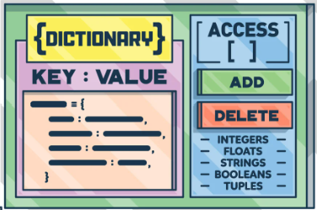

Dictionaries
A collection of key-value pairs that can be modified.
A dictionary is a collection which is ordered*, changeable and does not allow duplicates.
Tuples are written with round brackets { key:value, key:value }
Example:-
person = {"name": "Alice", "age": 25}
print(person["name"]) # Output: Alice
person["age"] = 26
print(person) # Output: {'name': 'Alice', 'age': 26}
*From python 3.7

Slide 24
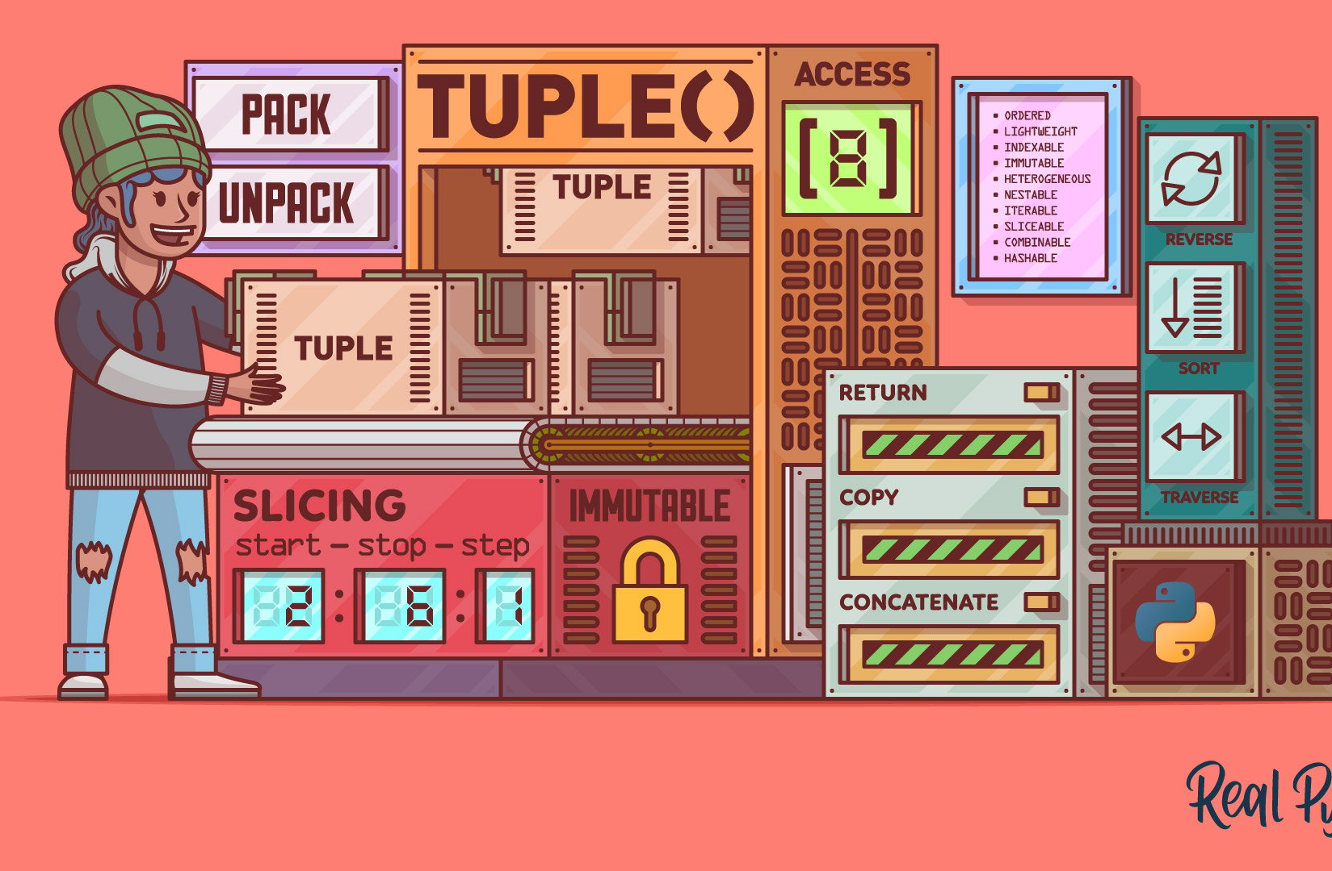
Tuples
An ordered collection of items that cannot be modified.
A tuple is a collection which is ordered and unchangeable.
Tuples are written with round brackets ( )
Example:-
coordinates = (10.0, 20.0)
print(coordinates[0]) # Output: 10.0
# Tuples are immutable, so the following line would cause an error:
# coordinates[0] = 15.0

Slide 25
Additional Resources
Cisco Python Essentials 1 https://skillsforall.com/course/python-essentials-1?courseLang=en-US
https://realpython.com/
https://www.w3schools.com/python/python_datatypes.asp
https://www.geeksforgeeks.org/python-programming-language-tutorial/

Slide 26
Preview of Next Week!!
Grasp the idea of conditional statements and loops.
Understand the concepts of indentation, iteration and incrementation.
Learn how to use logical operators within conditionals.
Understand the structure and use of loops.
Implement loops with complex data types.

Slide 27

THANK YOU FOR STICKING TILL THE END!!!
Here is a Special Easter Egg in Python
import this
Try it in your Python interpreter and see the result!

Slide 28


